Slide 1
CS 2600 Computer Networks I Dr. Sayeed Sajal Lecture 15 SONET and Error Detection

Slide 2
SONET Dual Ring Topology
OC-1,
OC-3
Router
From SONET and T1, 2nd Ed. by Black & Waters (Prentice Hall)

Slide 3
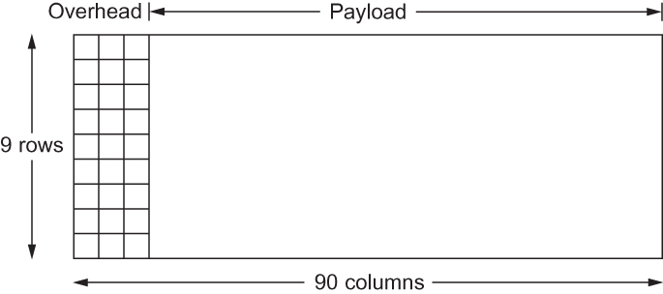
Figure 2.11 A SONET STS-1 Frame
(bytes)

Slide 4
Overview of the Error Detection Process

Slide 5
Characteristics of Error Detection Algorithms
The strength of the algorithm (the probability of detecting the error)
The transmission overhead (the number of error detection code bits added to message – typically 8, 16 or 32 bits)
The processing overhead (the amount of processing required to run it)
What system component(s) do the error detection?
The network adapter?
The main CPU?
Routers out on the Internet?

Slide 6
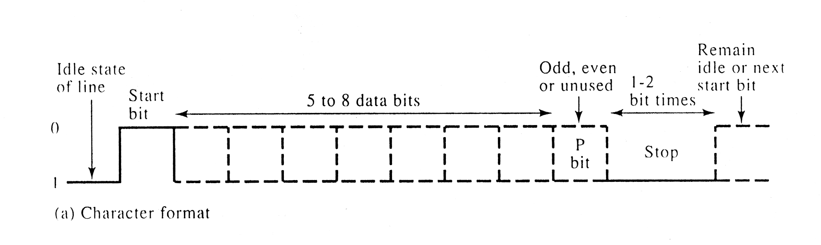
An Asynchronous Transmission (“Async”) Frame
From Data and Computer Communications, 4th Ed. by W. Stallings (Prentice Hall)

Slide 7
One-Dimensional (“Simple”) Parity
Parity calculation: count the number of 1-bits in the data and set the parity bit such that the total number of 1-bits is an even number (even parity) or an odd number (odd parity). When we used the 7-bit ASCII character set, there was room in each byte for the 8th parity bit. The UART* chip used in a serial port can calculate and verify simple parity.
*Universal Asynchronous Receive and Transmit

Slide 8
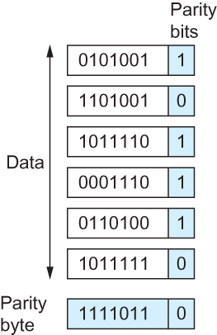
Figure 2.14 Two-Dimensional Parity*
*Even parity is illustrated in this example

Slide 9
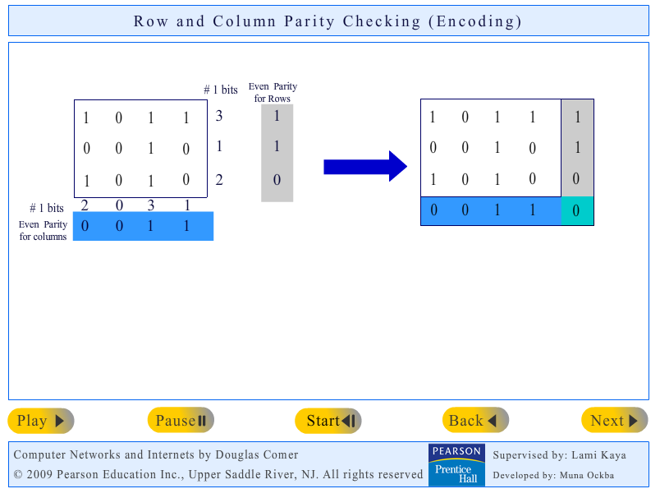
Doug Comer’s Two-Dimensional Parity Demo*
*Click the image to link to the simulation website
http://www.netbook.cs.purdue.edu/animations/even%20parity%20checking.html

Slide 10

Figure 2.8 PPP* Frame Format
Bits:

Slide 11
Internet Checksum Algorithm – One’s Complement Addition
Add the first 16-bit word in the message to the next. Add that sum to the third 16-bit word, etc. When a carry occurs in the sum (a 1 in the 17th bit position), add that carry back in to the least significant bit (right-hand) position. This limits the total length of the sum to 16 bits, so that the result will fit into the 16-bit check-sum field.
11111111 11111111
+ 00000001 01011101
1 00000001 01011100
00000001 01011100
+ 00000000 00000001
00000001 01011101

Slide 12
Implementation of Internet Checksum Algorithm in C (Based on text p. 95)
/* Internet Checksum Algorithm from the text, with comments added. */
/* IP, TCP, UDP, etc. would call this function to calculate a checksum. */
/* Returns 16-bit checksum: buf is msg ptr, count = # of 16-bit words */
u_short cksum(u_short *buf, int count)
{
register u_long sum = 0; /* accumulate 32-bit sum in register */
while (count--)
{
sum += *buf++; /* add 16-bit msg field to sum, incr. ptr */
if (sum & 0xFFFF0000) /* check for carry beyond 16 bit limit */
{
/* carry occurred, so wrap around */
sum &= 0xFFFF; /* get rid of high order carry bit */
sum++; /* add carry into least significant bit */
}
}
return ~(sum & 0xFFFF); /* AND out final sum, do a one’s complement */
}

Slide 13
The Cyclic Redundancy Check (CRC) Algorithm (1 of 4) (Based on text pp. 97 - 100)
Consider a message containing n bits as an (n – 1) degree binary polynomial. For example, the 8-bit message 10011010 can be expressed as…
M(x) = x⁷ + x⁴ + x³ + x¹
…where x is the base (2 in this case), so M(x) = 2⁷ + 2⁴ + 2³ + 2¹ = 10011010
Next, let k be the degree of a standard polynomial C(x), called the divisor
polynomial in the text or (more commonly) the generating polynomial (“GP”).
For example, if the generating polynomial is x³ + x² + 1 or 1101, then k = 3.
Before transmitting the original message M(x), the sender must convert it into a
form we’ll call P(x) which is exactly divisible by C(x), meaning no remainder.
If an error occurs during transmission, that will have the effect of adding a new term E(x) to P(x), which will make it very unlikely that the damaged P(x) will still be exactly divisible by C(x).

Slide 14
The Cyclic Redundancy Check (CRC) Algorithm (2 of 4)
In fact, P(x) will be exactly divisible by C(x) in only two cases:
1. No changes to P(x) occurred during transmission (i.e., no E(x) )
2. The error E(x) is also exactly divisible by C(x). Designers can make the probability of that extremely low by carefully choosing the generating polynomial value C(x).
The computation of P(x), which is done by the sending hardware, is a three step
process:
1. Take M(x), multiply it by x^{k}, and call this temporary result T(x). In our example, k = 3, so
T(x) = M(x) * x^{k}
T(x) = (x⁷ + x⁴ + x³ + x¹) * x³
T(x) = x¹⁰ + x⁷ + x⁶ + x⁴
T(x) = 10011010000
←
(We have effectively left-shifted M(x) by k bits.)

Slide 15

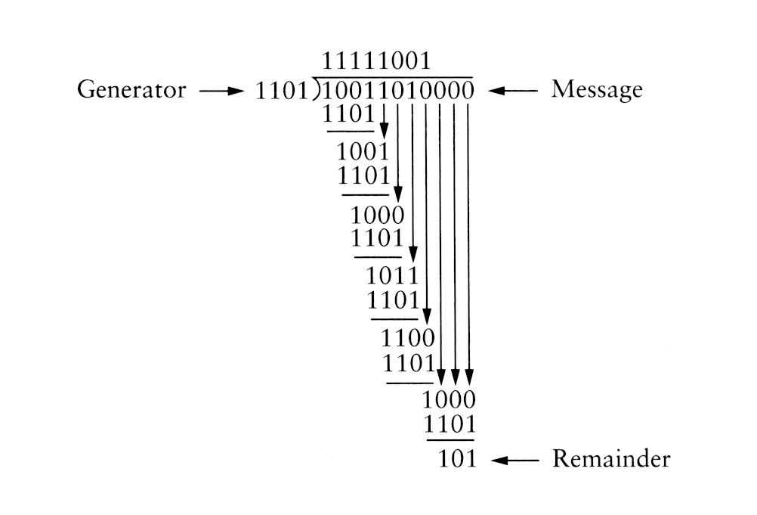
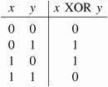
The Cyclic Redundancy Check (CRC) Algorithm (3 of 4)
2. Next, we divide T(x) (10011010000) by C(x) (1101), using modulo-2 polynomial long division. (In polynomial arithmetic, subtraction is defined as the logical XOR operation.)
C(x)
T(x)
Figure 2.17 CRC Calculation Using Polynomial Long Division
The result of the division is the binary remainder 101 and the quotient 11111001 (which is discarded).

Slide 16
The Cyclic Redundancy Check (CRC) Algorithm (4 of 4)
3. Since the remainder is 101, ( M(x) * x^{k} ) - 101 is exactly divisible by C(x).† So the sender transmits ( M(x) * x^{k} ) - 101.
To calculate ( M(x) * x^{k} ) - 101, we use XOR to perform the polynomial subtraction.
10011010000 (M(x) * x^{k})
XOR 101 (the remainder)
10011010101 (P(x))
So P(x) = 10011010101
Thus, we send 10011010101 (which is actually just the original message M(x) with the remainder appended to it).
When the message arrives, the receiver divides the incoming P(x) value by the
same generating polynomial C(x). If the remainder is zero, the receiver assumes
that there are no errors and removes the remainder (101) from P(x) to recover M(x).
†A similar example in decimal would be 11 ÷ 2 = 5 rem 1, so (11 – 1) ÷ 2 = 5 rem 0.

Slide 17
The Reliability of the CRC Algorithm
In general, a well chosen generating polynomial of R bits in length will detect:
All single-bit errors
All double-bit errors
All odd number of bit errors
All error bursts < R
For an error burst > R, the probability of an undetected error is still less than one in one trillion for a typical sized frame and an R ≥ 17

Slide 18
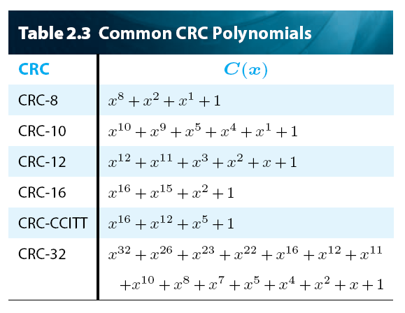
Table 2.3 Common CRC Polynomials
Used With:
ATM
ATM
HDLC
Variants
HDLC
Ethernet
& WiFi

Slide 19
Homework Question 12.
12. Give an example of a 4-bit error (i.e., 4 bits are changed in the message) that would not be detected by two-dimensional parity, as illustrated in Figure 2.14. What is the general set of circumstances under which 4-bit errors will be undetected? You can do this in handwritten form, but please write and scan it neatly so that columns line up, etc. (5 points)
Figure 2.14

Slide 20
Homework Question C.
C. What are the advantages of a CRC over the Internet checksum algorithm?
What are the disadvantages? (5 points)

